Slide 1
Responsible AI Hands-on Workshop
UK CSU All-hands
Mufajjul Ali
Pratim Das
Sonya Ang
Adelina Balasa
Malika Malik

Slide 2
Agenda
13:30 – 13:35
Introduction (Pratim)
13:35 – 13:50
Overview of Responsible AI (Mufy)
13:50 – 14:15
Interpretability with glassbox models (EBM) (Adelina)
14:25 – 15:00
Explain blackbox models with SHAP (and upload explanations to AML) (Sonya)
14:50 – 14:20
Model fairness assessment and unfairness mitigation (Malika)
14:20 – 15:30
Q&A/Wrap up (all)

Slide 3
Why Responsible AI?
Advancements in AI are different than other technologies because of the pace of innovation, and its proximity to human intelligence - impacting us at a personal and societal level.
Speech
Recognition
Speech
Synthesis
Language Understanding
Vision
Reading
Translation
2016
Object recognition human parity
2017
Speech recognition human parity
2018
Reading comprehension human parity
2018
Machine translation human parity
2018
Speech synthesis near-human parity
2019
General Language Understanding human parity
Notes:
As the AI moving into mainstream, the decision it makes will have a negative or positive on our livelihood, therefore we need AI to be responsible.
We need to understand :
Why did my model make this mistake?
Does my model discriminate?
How can I understand and trust the model’s decisions?
Does my model satisfy legal and regulatory requirements?
Is my use case considered high-risk for AI?
Can my model be reproduced or stolen?

Slide 4


Responsible ML capabilities
Customers
Azure Machine Learning
Understand
Interpretability
(new interactive dashboard)
Fairness (integration of FariLearn in June)
Protect
Differential Privacy (new WhiteNoise OSS toolkit)
Confidential machine learning
(coming soon)
Control
Audit trail
Datasheets
Notes:
3 pillars of responsible AI -->
Interpretability – Gain visibility into models to improve them and explain model behavior
Fairness – Detect and mitigate bias in model while maintaining accuracy
Differential Privacy – Protect sensitive data and prevent privacy leaks
Confidential ML – Encrypt data and models to maintain confidentiality in a trusted environment
Datasheets – Document model metadata to ensure accountability and meet regulatory requirements
Audit trial and management – Track data and models, show lineage, apply policies and manage resources
→

Slide 5
Azure Machine Learning
Understand
Interpretability
Fairness

Slide 6
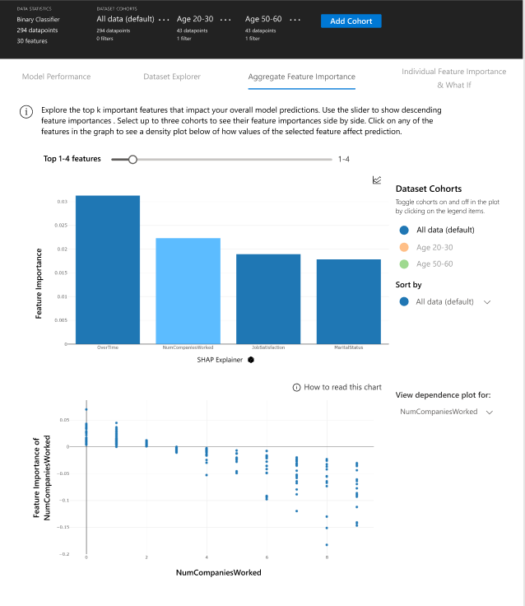

Interpretability
Types of Models Supported
Understand the behavior of a wide variety of models
Build accurate machine learning models
Perform what-if analysis
Glassbox
Blackbox
Introducing Explainable Boosting Machines (EBM)
Lossless Explanations
State-of-the-art accuracy
Automatic Interaction Detection
Memory and CPU efficient prediction
Notes:
Glass-box models are interpretable due to their structure. Examples include: Explainable Boosting Machines (EBM), Linear models, and decision trees. Glass-box models produce lossless explanations and are editable by domain experts.
Black-box models are challenging to understand, for example deep neural networks. Black-box explainers can analyze the relationship between input features and output predictions to interpret models. Examples include LIME and SHAP.
Local explaner – individual data point
Global explainer – all the data points

Slide 7
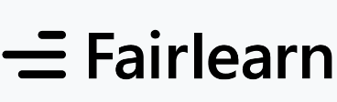
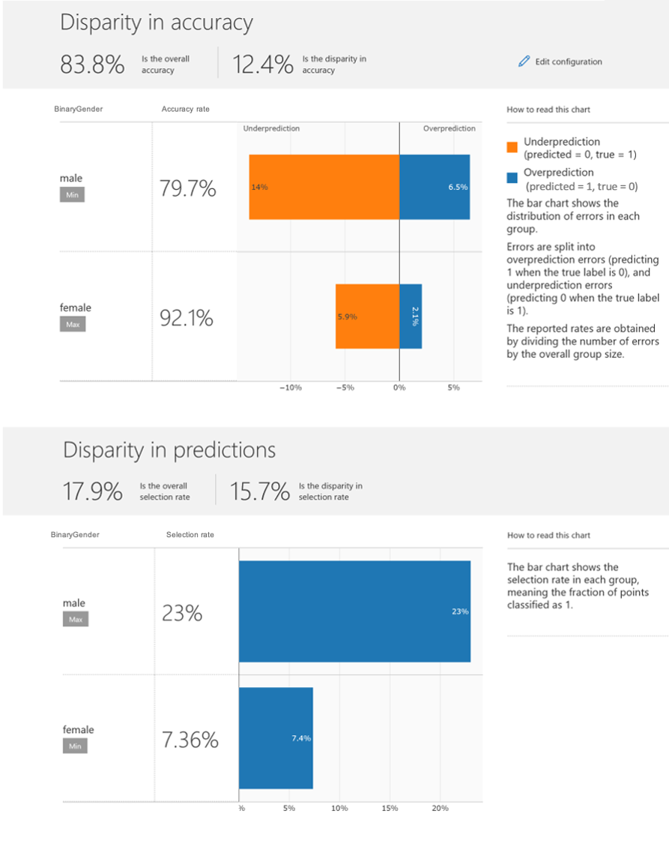
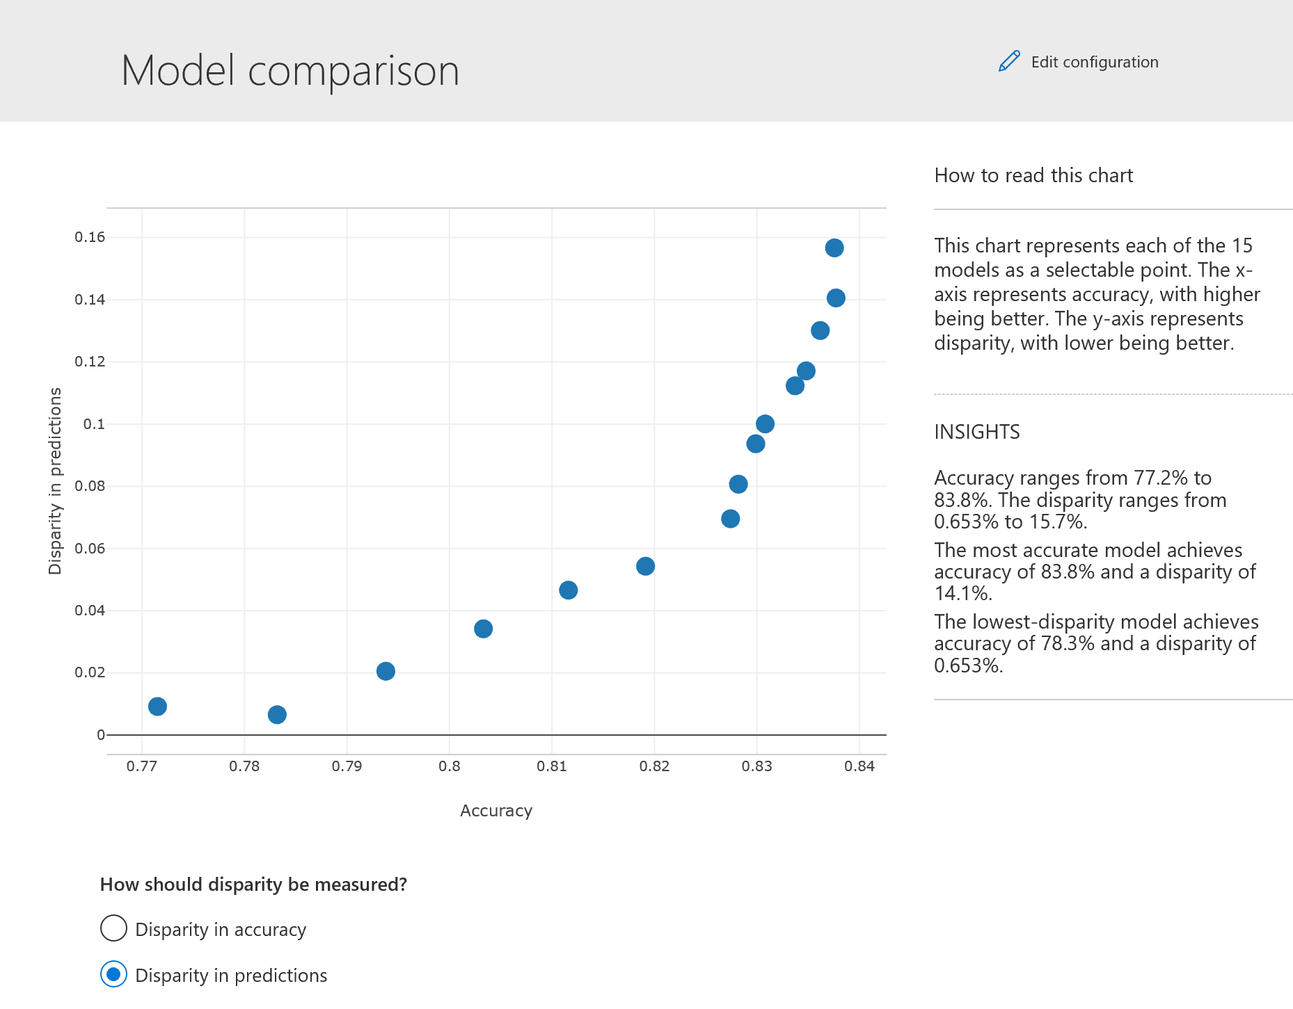
Fairness
Assessment:
Use common fairness metrics and an
interactive dashboard to assess which groups of people may be negatively impacted.
Fairness Mitigation:
Use state-of-the-art algorithms to mitigate unfairness in your classification and regression models
Notes:
Model is making a fair decision, is not discreminating in anyways
--> Detect and mitigate bias
Toolbox --->
Two techniques to address fairness issue: Assessment & Mitigation

Slide 8
Environment Setup
GitHUb
Create AML Workspace
Create AML Compute Instance
Create AML Compute Cluster
Clone GitHub repo in your Compute Instance Workspace
Run Jupyter Lab
https://github.com/mufajjul/ResponsibleAI-Airlift-Aug2020
AML Portal
https://ml.azure.com/

Slide 9
Feedback
https://forms.office.com/Pages/ResponsePage.aspx?id=v4j5cvGGr0GRqy180BHbR_9hazCQxTxIoxmc5_hnHc1URTdLVE8wNkVWV0pQMTZZRVM2T1VPVEFKSy4u

Slide 10
Responsible ML Resources
ML Checklist :
Responsible ML Pitch deck
Responsible ML build 2020 FAQ
Links available at build:
Announcement Blogs:
https://aka.ms/Build2020_ResponsibleML
https://aka.ms/AA87dvc
ACOM responsible ML page:
https://azure.microsoft.com/services/machine-learning/responsibleML
Docs:
https://docs.microsoft.com/en-us/azure/machine-learning/concept-responsible-ml
Customer stories:
https://aka.ms/sasbuild
https://aka.ms/eandybuild
Toolkits and samples
FairLearn
Available today: https://github.com/fairlearn
https://aka.ms//FairLearnWhitepaper
https://docs.microsoft.com/azure/machine-learning/concept-fairness-ml
InterpretML
Available today: https://github.com/interpretml
https://aka.ms//InterpretMLWhitepaper
https://docs.microsoft.com/azure/machine-learning/how-to-machine-learning-interpretability
WhiteNoise
https://github.com/opendifferentialprivacy
https://docs.microsoft.com/azure/machine-learning/concept-differential-privacy
https://docs.microsoft.com/azure/machine-learning/how-to-differential-privacy
Https://aka.ms/WhiteNoiseWhitePaper
Datasheets
https://www.microsoft.com/en-us/research/publication/datasheets-for-datasets/
https://github.com/microsoft/MLOps/blob/master/pytorch_with_datasheet/model_with_datasheet.ipynb

Slide 11
